Slide 1
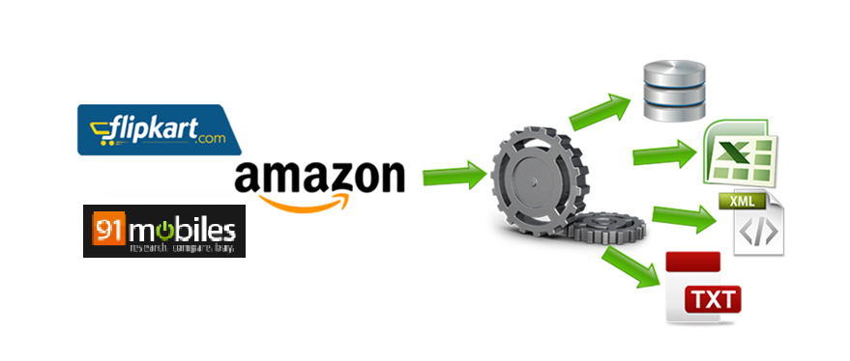
ECOMMERCE CUSTOMER’s REVIEW EXTRACTION
Presented By
Likhil Kumar Rachuri(lkr46)
Shyam Prasad Sukumar(ss4978)
Anandhi Solaimuthu(as5326)

Slide 2

Table of Contents
Conclusion
Background
01
06
ECOMMERCE CUSTOMER’s REVIEW EXTRACTION
02
Challenges
Project Scope
05
03
04
Technique and Tools
Data Sources
Notes:
© Copyright PresentationGO.com – The free PowerPoint and Google Slides template library

Slide 3

Background
The e-commerce business is developing rapidly these years, buying products on-line has become more and more trendy owing to its variety of options, low cost value (high discounts) and quick logistics systems, so abundant folks intend to do online shopping.
On the downside the quality and originality of merchandise is uneven, fake branded products are getting delivered. Hence users’ comments has become the vital data to evaluate the product’s quality and merchandise.
Our aim was to create a one place store where user can get every details of the product at that place for which the data can be scraped from multiple sites, including the reviews and our analysis on those reviews.

Slide 4
Project Scope
Our main focus was to extract the reviews part from popular Ecommerce website and create a dataset, which on analyzing thoroughly the user will get a final line review for the product.

Slide 5


Data Sources
Flipkart(https://www.flipkart.com/)
Flipkart is an Indian e-commerce company. The company initially focused on book sales, before expanding into other product categories such as consumer electronics, fashion, and lifestyle products.
91mobiles(https://www.91mobiles.com/)
91mobiles.com is the largest gadget discovery site in India, focused on smartphones. It provides information and interactive tools to help people decide which phone to buy and where to buy it from. We are extracting the reviews of the mobile by amazon from this site.

Slide 6
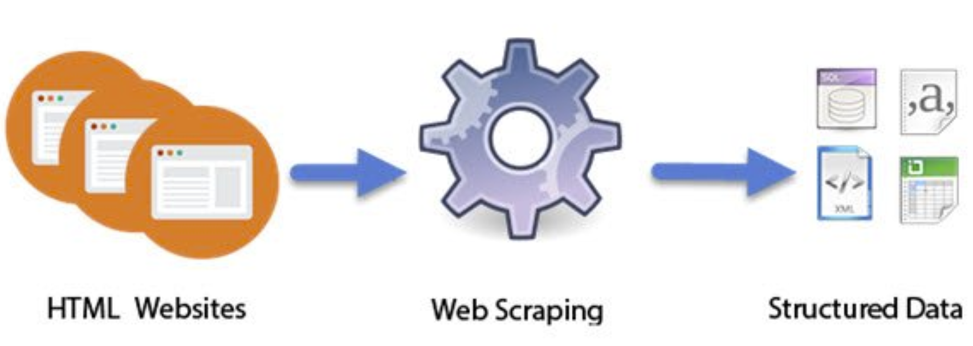
Technique and Tools
Technique used
Web scraping
Tools used
Python
Selenium
Beautiful Soup
Chromedriver

Slide 7



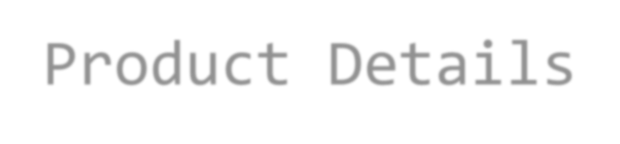
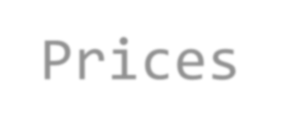






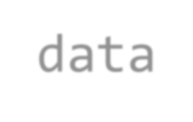

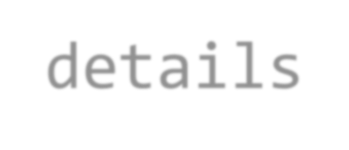
Dataset Overview
Using Web scraping below are the things which was scraped from website .

Slide 8
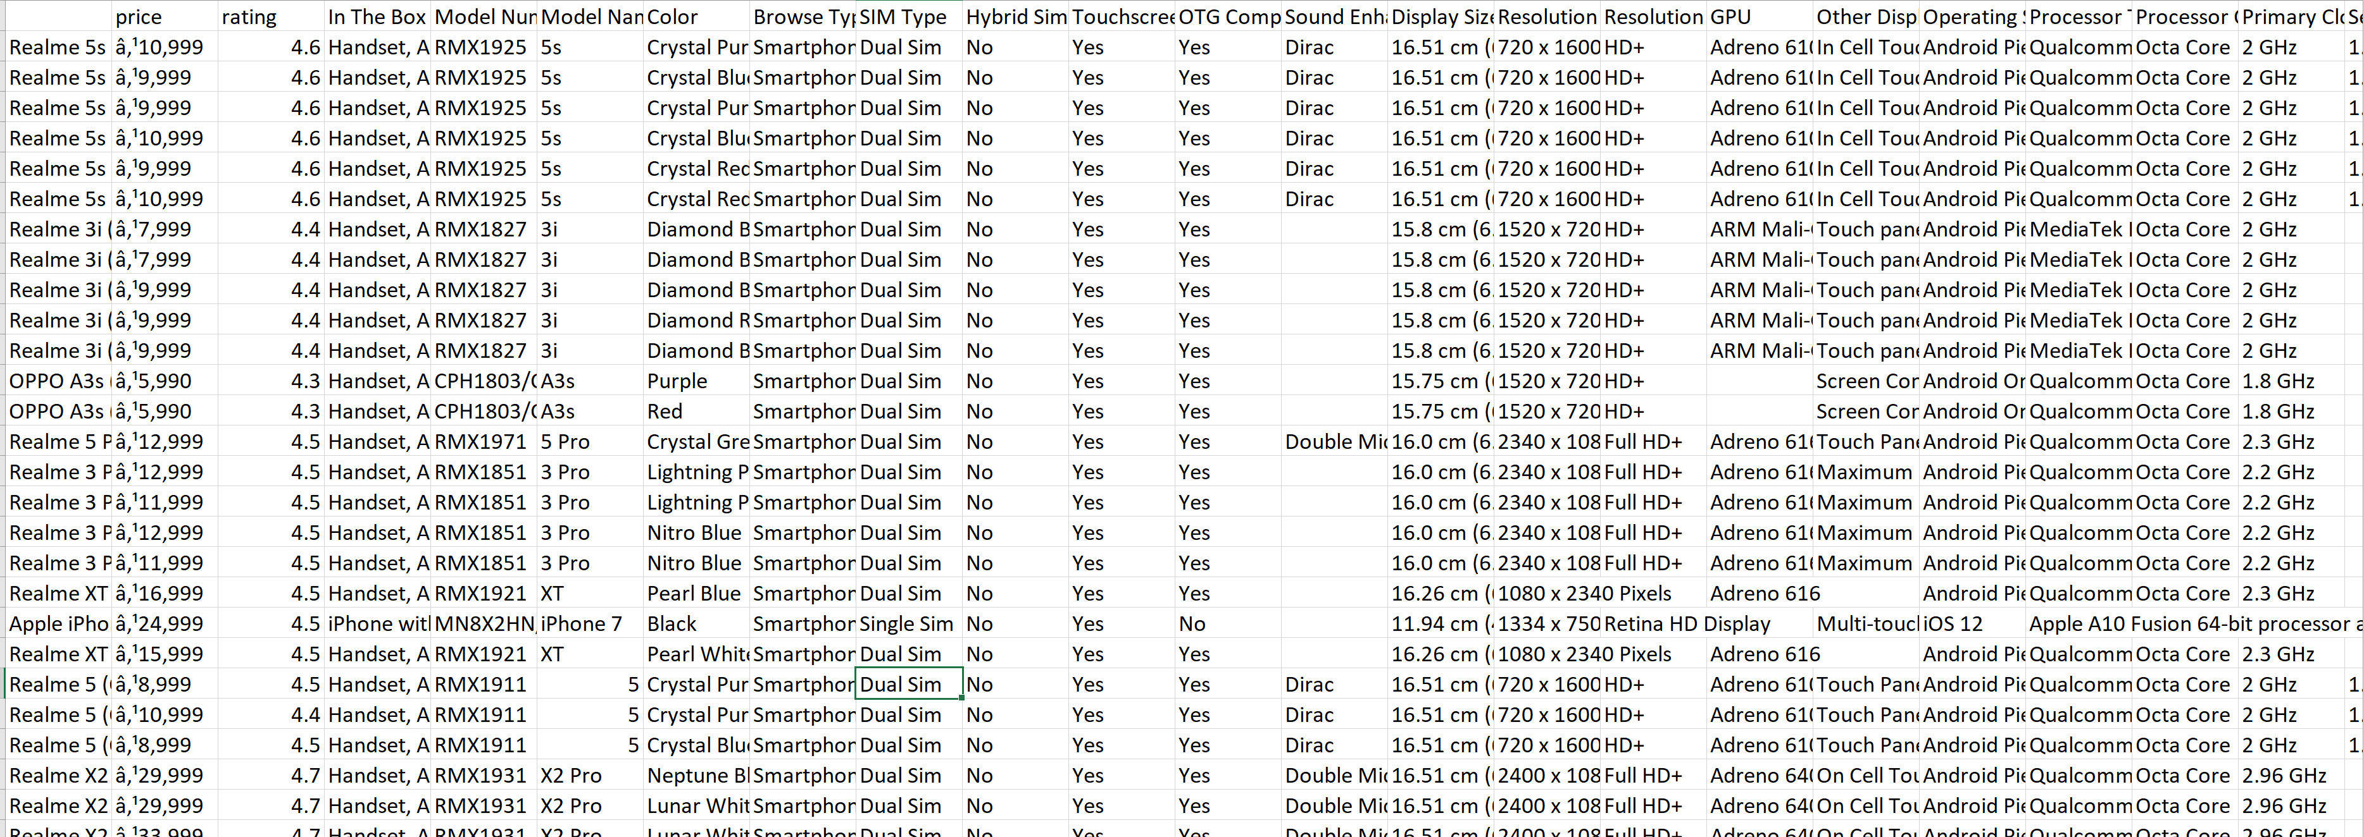
Dataset Overview

Slide 9
Challenges
Flipkart is a commercial e-commerce website, where the filter to primarily fetch phones according to their brands was in their home page. We developed our code to scrap according to the structure, But as it is a commercial website, there was a sale happening on Dec 1st and entire structure has been re-formatted from their end for sale. This made us to use another approach for fetching the mobiles, that was by search key.
In 91mobiles, the reviews we can get by scrolling the page, which was quite a new task and we achieved it with selenium.
While scraping, there was a high chance where site used to block us. If we focus on creating a single dictionary and store each element as a product, when it fails, all the stored information was locked and went of no use. So we followed a method to append each element to the file once it is done.
This append further created a problem, as the file which gets individual dictionaries is not in a json format as the append just adds to the end of the file. We did convert the whole file to a string and individually looped over a pattern and added numbers as the key to it. So it was into json format.
There are some junk characters in price like Indian rupee symbol which are hidden and not being able to remove. Need to research more on how to remove them.
Limitation: We can scrap from various sites but as these E-commerce sites are commercial, we are not allowed/authorized to scrap.

Slide 10
Conclusion and Future work
Final datasets we produce are three, where in two for exclusively flipkart and amazon, other is the dataset where phones contain both amazon and Flipkart reviews.
This dataset can be used in various ways. It is a pool of information for the specific phone.
Future Work:
Need to analyze all the reviews for a particular smartphone by using various methods like text analytics and sentimental analysis with the help of natural language processing a final verdict or overall review should be given for the specific phone which covers the gist of almost all the customer reviews. This will help the customer to make his decision quicker than going through several reviews and being ended up in mess.

Slide 11
THANK YOU !!

